Slide 1

Otterbourne Church of England Primary School
Volunteer Presentation

Slide 2
Signing In and Out
Visitors and volunteers need to sign in to school via the ‘EntrySign’ system in the foyer, which will print out a wearable sticker/badge.
All visitors to the school, should either clearly display this badge or wear a ‘visitor’ lanyard. Please note that staff, governors, engineers and other visitors will also wear a lanyard.
The badge must be easy to see at all times whilst in school. We encourage adults and children to challenge this, so please accept that this is part of our safeguarding approach.
When leaving, it is easy to ‘sign out’ – simply present the QR code to the little scanner and wait for the beep.

Slide 3
Safeguarding
Please ask for further support or clarification if needed.
Safeguarding in our school is everybody’s responsibility.
PLEASE ALSO ENSURE YOU HAVE READ YOUR COPY OF OUR SAFEGUARDING LEAFLET

Slide 4
Safeguarding Concerns
There is a process for raising concerns, if you have them:
  If you have a concern about a pupil report this immediately to a DSL (Designated Safeguarding Lead): Caren Reid, Martin Geraghty, Hannah Whitbread or Kay Davenport
If it is about a member of staff, report this immediately to the Headteacher (Martin Geraghty)
All other concerns should be addressed to the Chair of Governors (Sue Barham)
Further details are in our safeguarding leaflet.
Thank you for your support in safeguarding our community.

Slide 5
Confidentiality
Please only discuss children, their progress or concerns with the class teacher or LSA in the class.
To keep our school safe, we need to keep details confidential.
Anyone working or volunteering in school must maintain confidentiality and not discuss anything about our children in public areas, on the playground or outside of school.

Slide 6
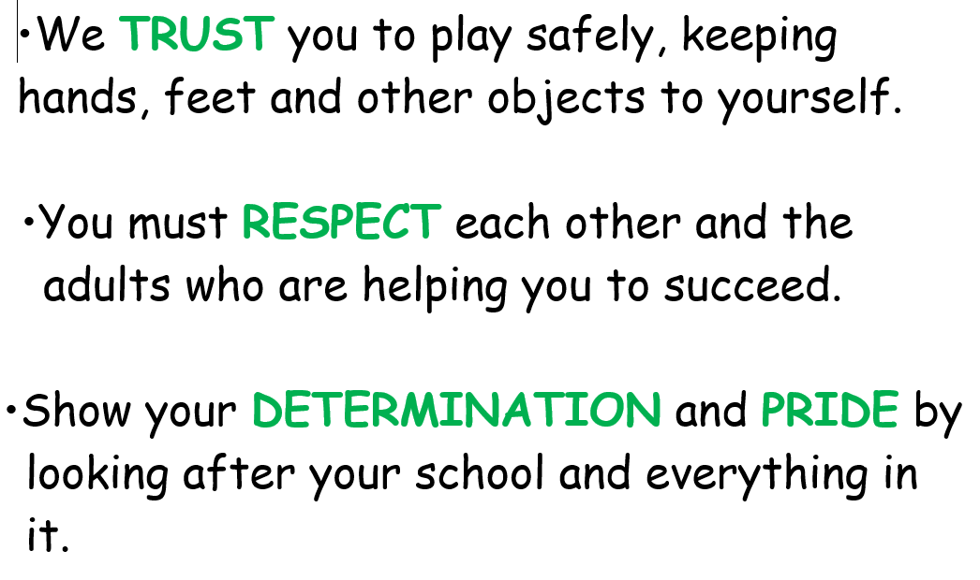
Behaviour
Children are expected to be respectful to all adults in the school.
If a child acts in a disrespectful way, please seek help from a teacher or a teaching assistant rather than trying to resolve the situation yourself.
Our 3 school rules:

Slide 7
Fire Safety
Fire Assembly Point
Following a fire alarm sounding, please make your way to the playground in front of reception and report to a member of staff from the office.
Silence Please
Everyone is expected to move around the site in silence in the event of a fire alarm sounding.
Please note that the fire alarm is a continuous bell.

Slide 8
Toilets
If you need the toilet during your visit, please ask a member of the office staff who will direct you to the adult toilets.
Under no circumstances are volunteers to use the children’s toilets.

Slide 9
Mobile Phones & Electronic Devices
If you are expecting an important call whilst in school, please talk to the office team and leave your phone with them. We will always be discrete but must ask that mobile phones are never in view of children.
School iPads are always available should there be a need to take photos.

Slide 10
Personal Belongings
Please feel free to leave your coat and bag in the staffroom, with the office team, or in an agreed safe place in the classroom you are supporting.
IF YOU KEEP YOUR MOBILE WITH YOU, PLEASE PUT IT IN AIRPLANE MODE.

Slide 11
Breaks
Please be aware that all breaks must be taken in the staffroom and not in the playground.
Hot drinks are not permitted to be carried around school unless they are in a lidded cup.

Slide 12
Other issues
If a child you are supporting feels unwell please inform the class teacher.
Please do let the class teacher know if you are unsure of a task as they are always willing to help.
If a child you are supporting asks to go to the toilet, please let them go, but we only allow one child to go at a time.

Slide 13
Thank you for volunteering!
Your support is very much appreciated

