Slide 1
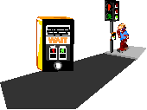

How to be a safe pedestrian

Slide 2
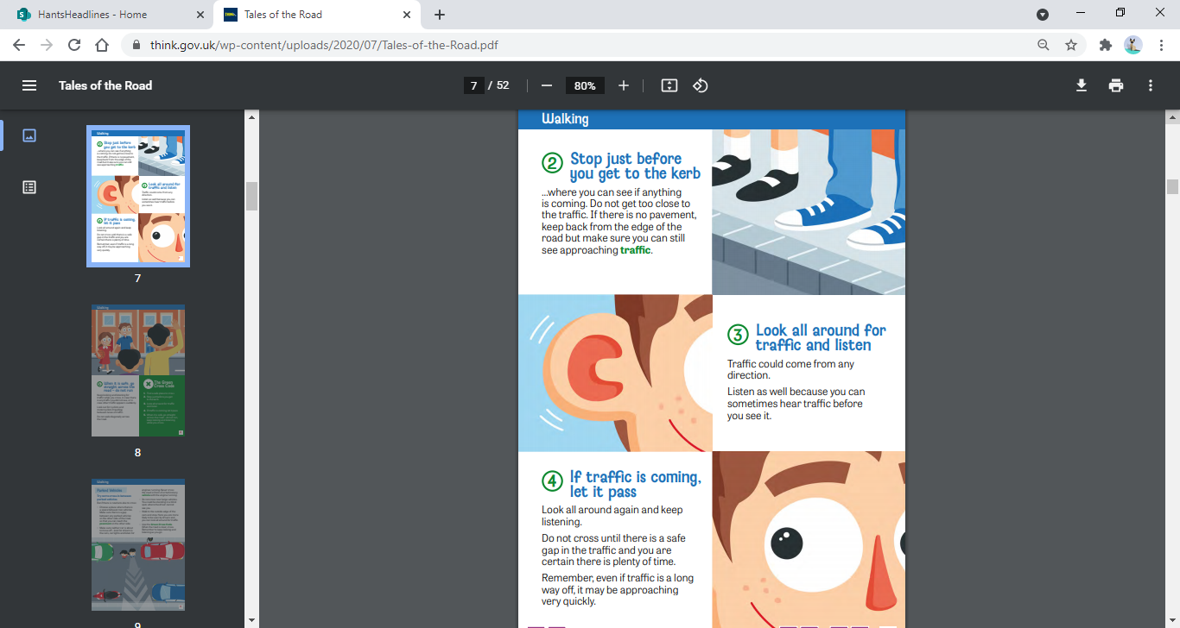
What do we need to think about……
Before we cross the road?
Whilst we are crossing the road?

Slide 3
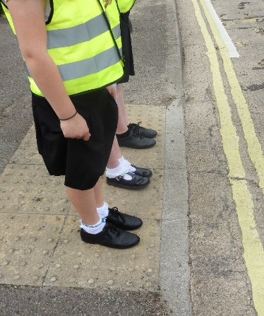


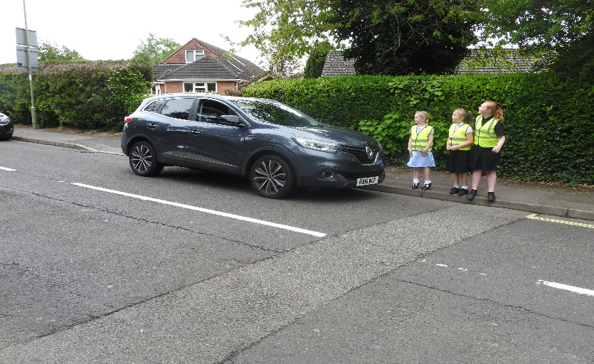

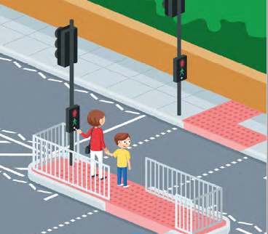
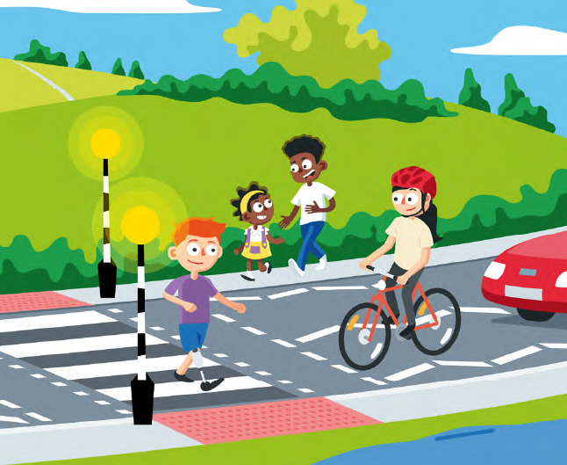
Green Cross code
Find
Find a safe place to cross - then stop.
Stand on
Stand on the pavement - away from the edge of the kerb.
Look and listen
Look and listen for any traffic - don’t be distracted.
Walk
When clear, walk straight across the road – not diagonally. Do not cross If there is traffic coming.
Keep
Keep looking and listening for traffic as you cross the road.

Slide 4
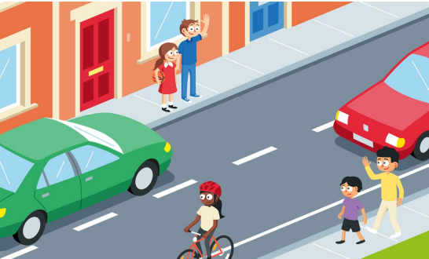
Safe crossing places
Where is a safe place to cross?
If there wasn’t a specific crossing place…..
Where would you cross?
Where shouldn’t you cross?

Slide 5


If there is not a specific crossing place……
Cross where you can see what is coming
Cross on a straight road – not on a bend
Be patient – wait until the road is clear
Do not cross between parked cars

Slide 6
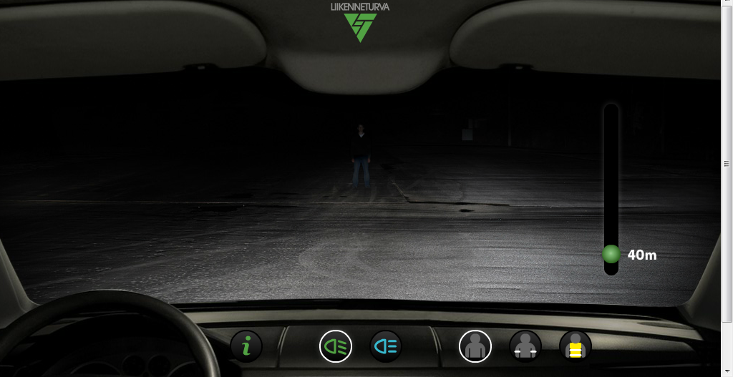

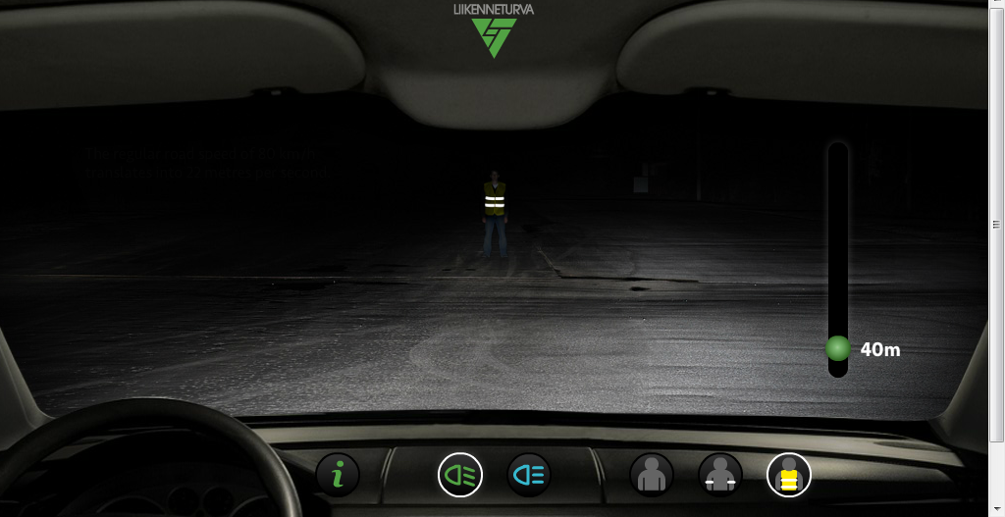
BE BRIGHT BE SEEN
Always wear something bright…..
  Day = fluorescent
  Night = reflective
Make sure you can be seen by the traffic - don’t be invisible
In which photo can you spot the person more easily?

Slide 7

ALWAYS remember to:
STOP - find a safe place to cross
LOOK – can you see any traffic coming?
LISTEN – can you hear any traffic coming?
THINK – check again, if it's safe to cross, walk across the road – continuing to look and listen for traffic

