Slide 1
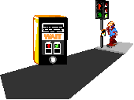
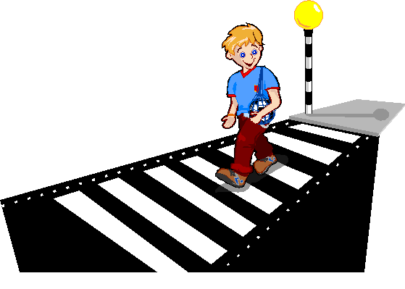
How do we cross the road safely?
Notes:
Explain to the children that we are going to answer this question today –
What we have to do to cross the road safely.
What do they notice about the pictures?
Does anyone know what these are called?
These are some safe crossing places that we can use on busier roads.
Today we are going to talk about what code/rules we have to use to cross the road safely – this means when we are using some of these crossing places or when we are crossing the road anywhere.

Slide 2
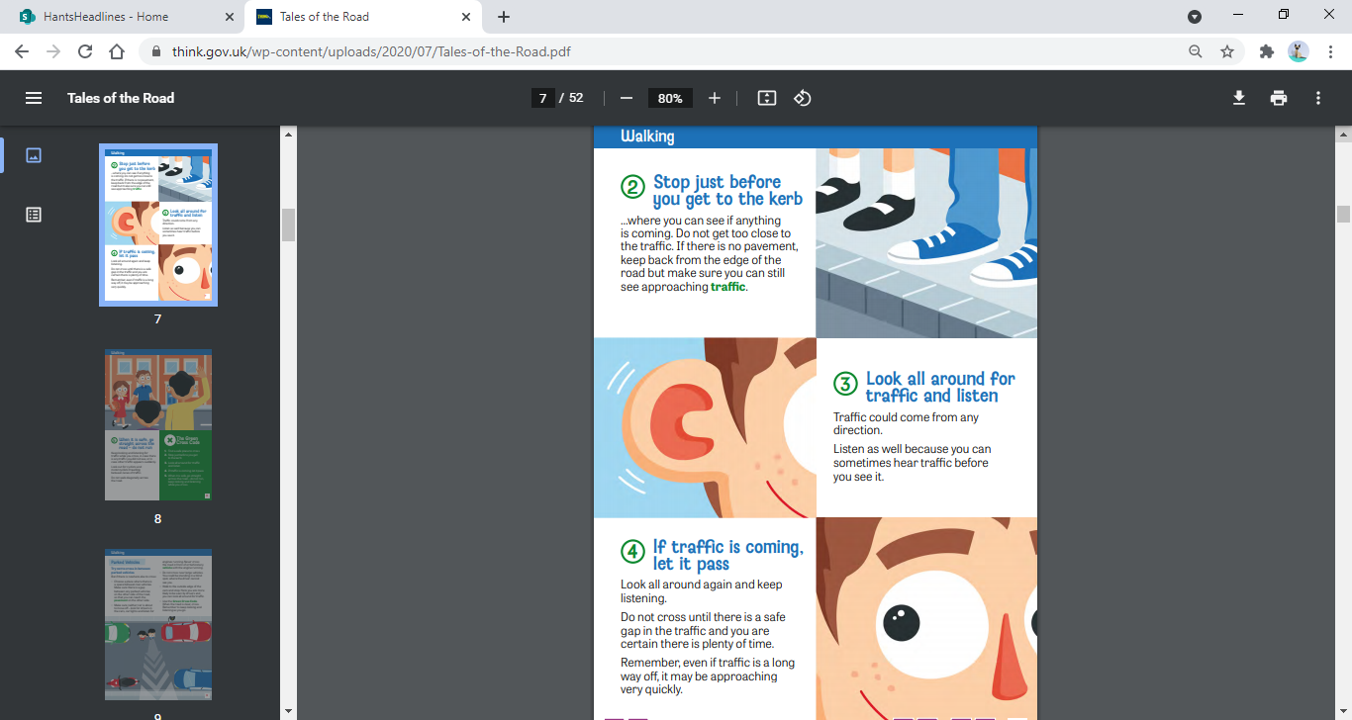
What three things do we need to do before we can cross the road safely?
Notes:
These are the three key things we need to do when crossing the road – we must:
STOP – does anyone know where we would stop
LOOK – what are we looking out for?
LISTEN – what are we listening out for?
Why do we need to look and listen for traffic?

Slide 3
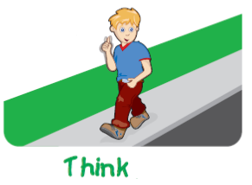
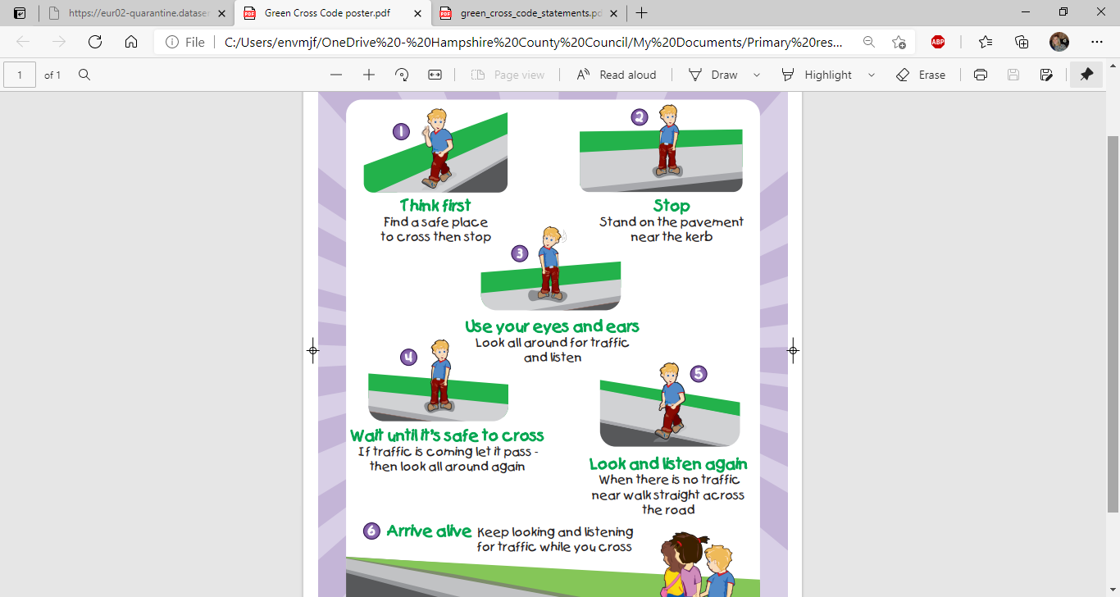
Find a safe place to cross and stop
Notes:
This is the first thing we must do – find a safe place to cross and stop.
Remind the children of crossing on a straight road where you can see what's coming.
Where would be a safe place to cross?
Refer back to the crossing places as well as talking about straight pieces of road, not on a bend

Slide 4
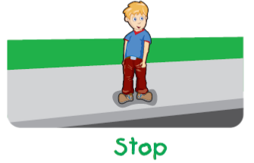
Stop just before you get to the kerb
Notes:
Stop – just before you get to the kerb. Ask if they know why we stop a bit further back from the edge.

Slide 5
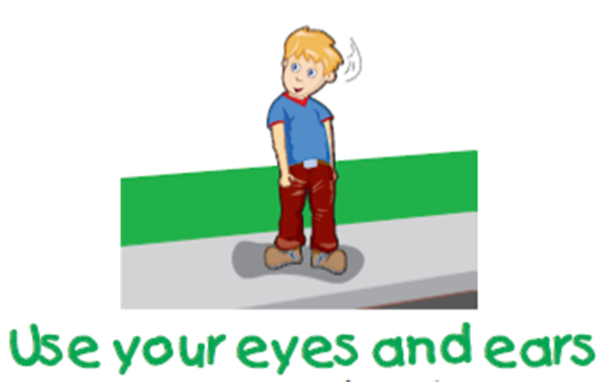
Look and listen all around for traffic
Notes:
Look and listen for traffic – ask again why we need to do both.
Remind them that we should only be concentrating on the road – not chatting or messing around. Off our scooters and bikes too.

Slide 6
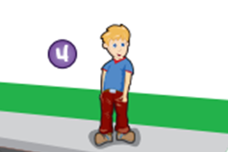
If traffic is coming, let it pass – then look all around again
Notes:
Be patient – wait for it to be clear.
If the road is busy, it might have a crossing place – it may make our journey a bit longer, but it is much safer to walk that bit further and use it.

Slide 7
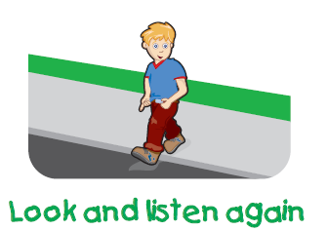
When the road is clear, walk straight across.
Keep looking and listening when you cross.
Notes:
When it is clear – walk straight across.
Ask them what we shouldn’t do when crossing the road?
Why shouldn’t we run across the road?
Why should we keep looking and listening when we cross the road?

Slide 8
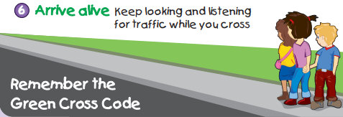
Notes:
If we have done all of this and have kept concentrating on the road, we will always get across safely.

Slide 9
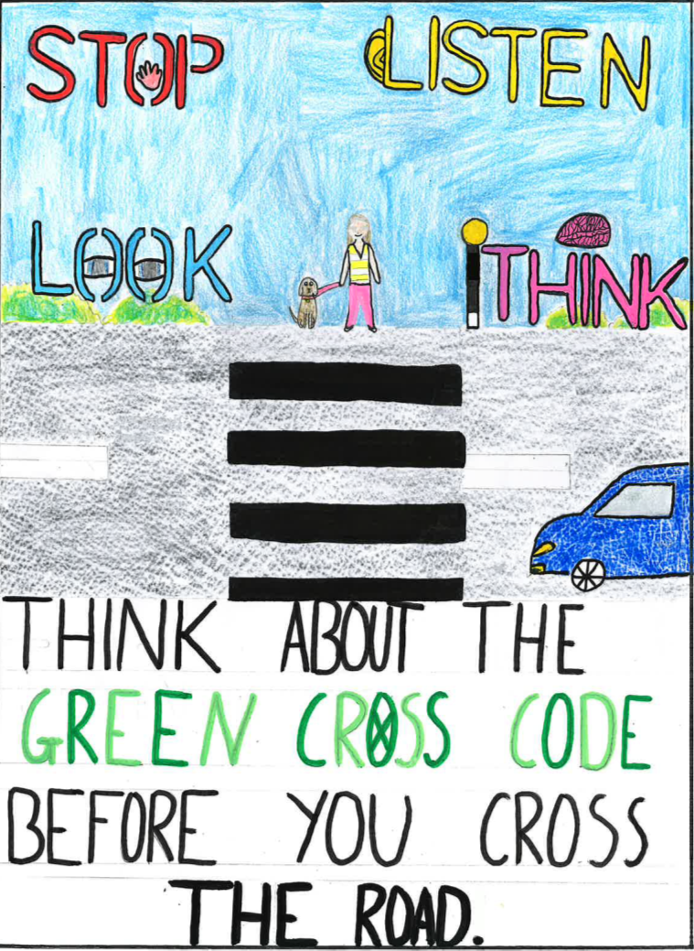
What do we need to remember?
Stop
Look
Listen
Think
Notes:
Recap these messages – explaining that they should always hold an adults hand too.

