Slide 1
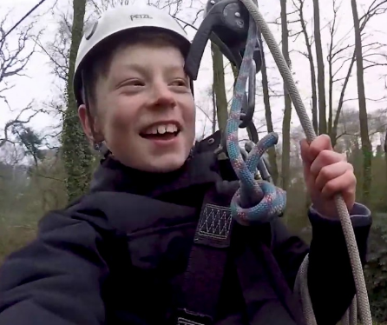
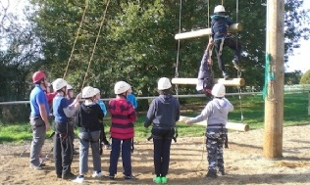
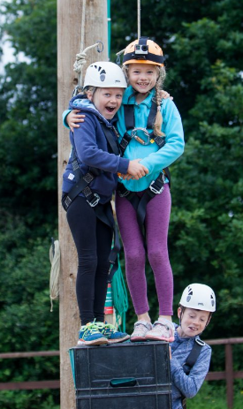
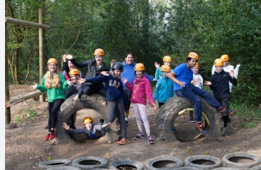
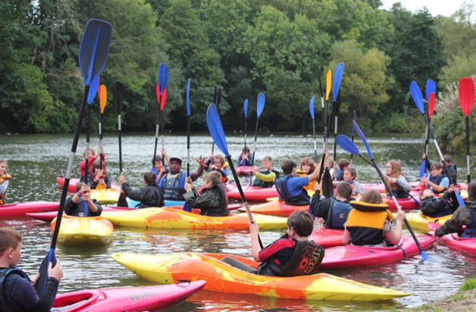
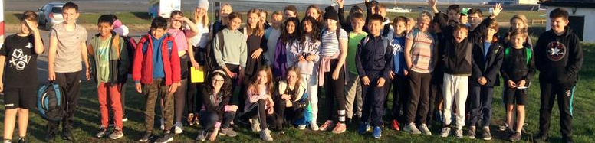

Otterbourne C of E Primary School
Year 6 Residential Visit to Fairthorne
25th-29th September 2023
Notes:
Clare

Slide 2
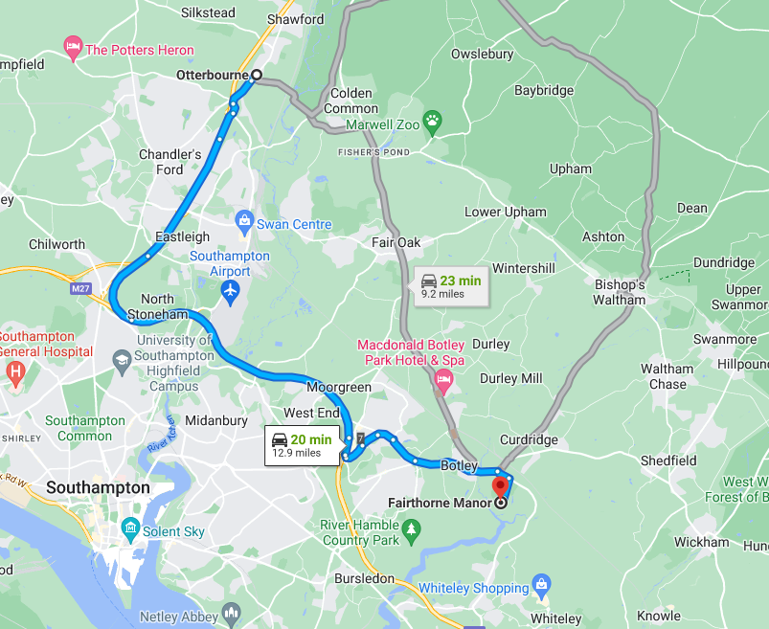

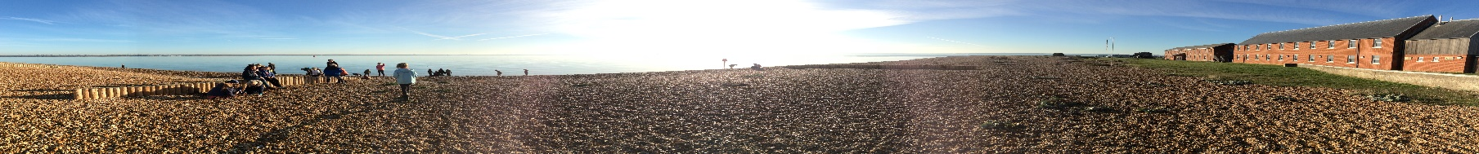
Where is Fairthorne Manor?
Notes:
Clare Introduce by saying that it will give the audience an insight into some of the activities that their children may be taking part in and hopefully give them an idea of the site and what to expect during the week.
It should hopefully answer a lot of the questions they may have but they will have an opportunity to ask questions later.

Slide 3
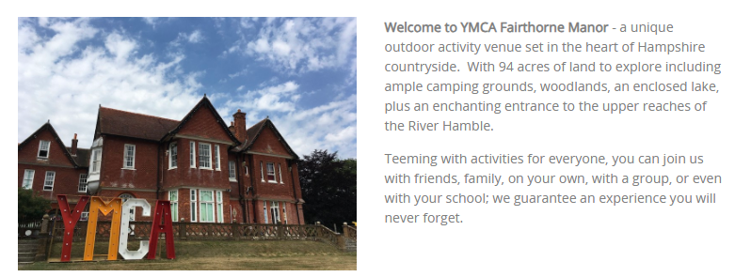
YMCA Fairthorne Manor
Notes:
Clare

Slide 4
Who is going?
Mrs Holland (Trip Leader)
Mr O’Dowd
Mrs Simpson (Tues to Fri)
Mrs Armstrong
Mrs Johnson (Mon to Tues)
Notes:
Clare Points to cover:
Who is going- majority of staff have been before with a range of year groups, so are confident with how the trip works, the ins and outs etc. Explain arrangements for looking after children across the trip- accommodation, groups etc.

Slide 5
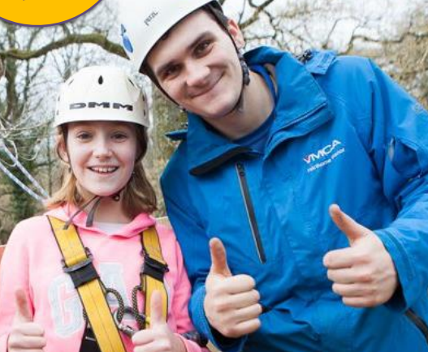
Before the trip - Children
Children will be given a short presentation in class all about the trip
  Some activity information
  Bedding arrangements
  Kit list to check at home
  Food
  Group preferences
Children will be given opportunities to ask questions – already begun!
Children will not find out their room groups, activity groups or activity schedule until the journey down/arrival.
Notes:
5
CAMPBELL Explain in the run up to the trip, children will receive information to reassure them and explain to them how the trip will work.
Children will be given a short presentation about the trip, covering information that will be covered within this presentation, and will be given information about things such as activities, how the activities will work, accommodation, food etc.
The children will be given the opportunity to ask questions and share any worries with the aim of reassuring them.
A ‘calshot pot’ will be put in Class LH, in which children can write any extra questions they can think of in the run-up to the trip / questions they perhaps don’t want to ask in front of others, and they will be answered either to the class group if relevant, or to the individual.

Slide 6
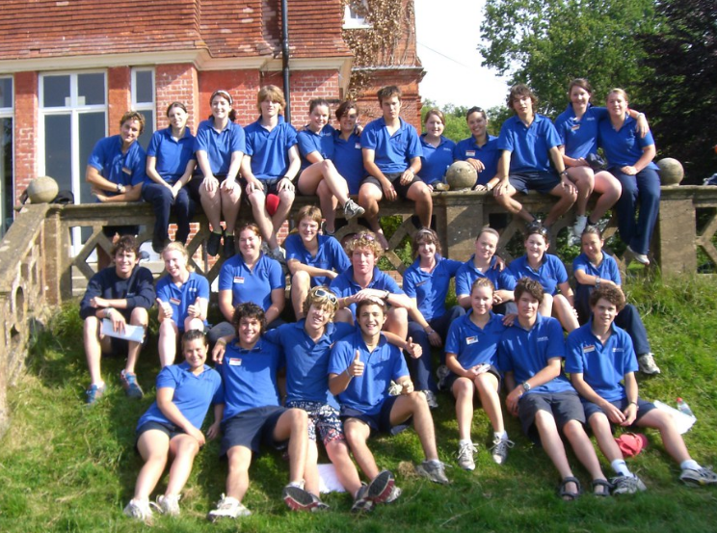
Arrival Day!
A very exciting day!
Children to come into school with all of their luggage at normal school time
They will learn who their group leader is and which other children are in their group
They will find out who they are sharing a room with when we arrive – groups are slightly different to room buddies.
The coach will leave around 10am
Notes:
6
CAMPBELL This will be a day full of excitement and nerves!
The children will need to arrive at school at the normal time of 8.50, and they will need to drop their luggage off within the school (drop-off point to be arranged closer to the time!)
We will not be leaving until 10am. In this time between arrival at school the children will be taken through the day and what will be happening upon arrival etc. This will also allow adequate time to ensure that all children have necessary things with them, and that all necessary medication has been collected and accounted for. Parents are welcome to stay and wait in the playground in order to wave goodbye to the children as we drive off, but we urge you to consider whether this could induce any nervous ‘wobbles’. However, help with carrying luggage down to the coach would very much be welcomed!
There will be around a 50 minute drive to get to the activities centre- travel sickness!

Slide 7
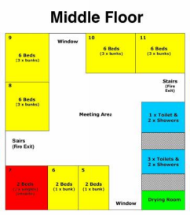
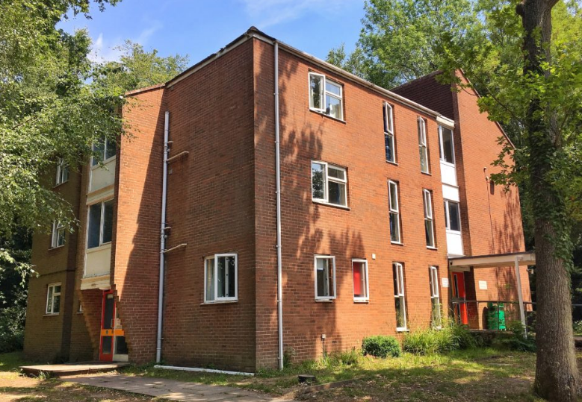

Accommodation
Notes:
CAMPBELL Upon arrival, we will be taken to our accommodation- this is a secure, key-coded building that only we will be able to access for the duration of the trip.

Slide 8
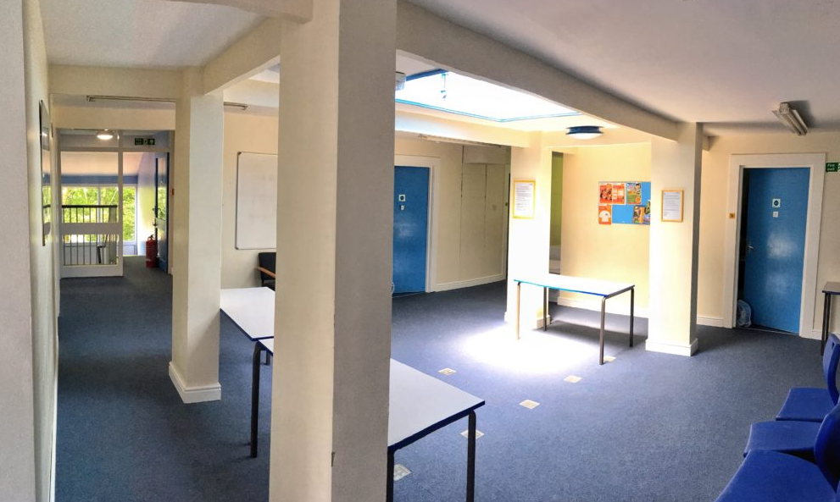
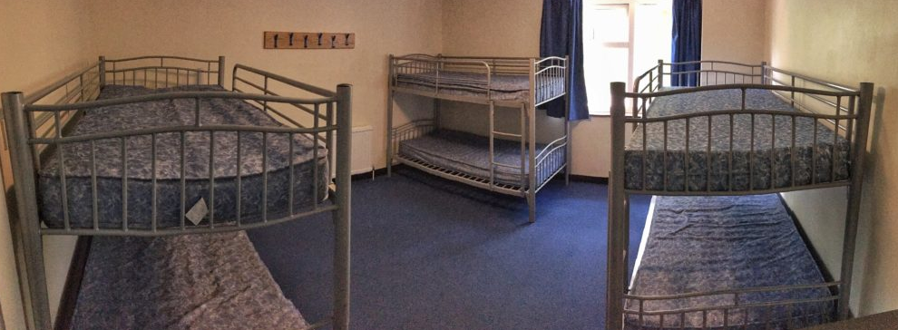
Notes:
CAMPBELL

Slide 9
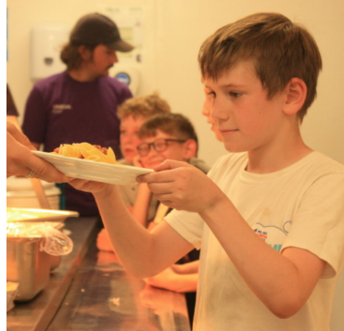
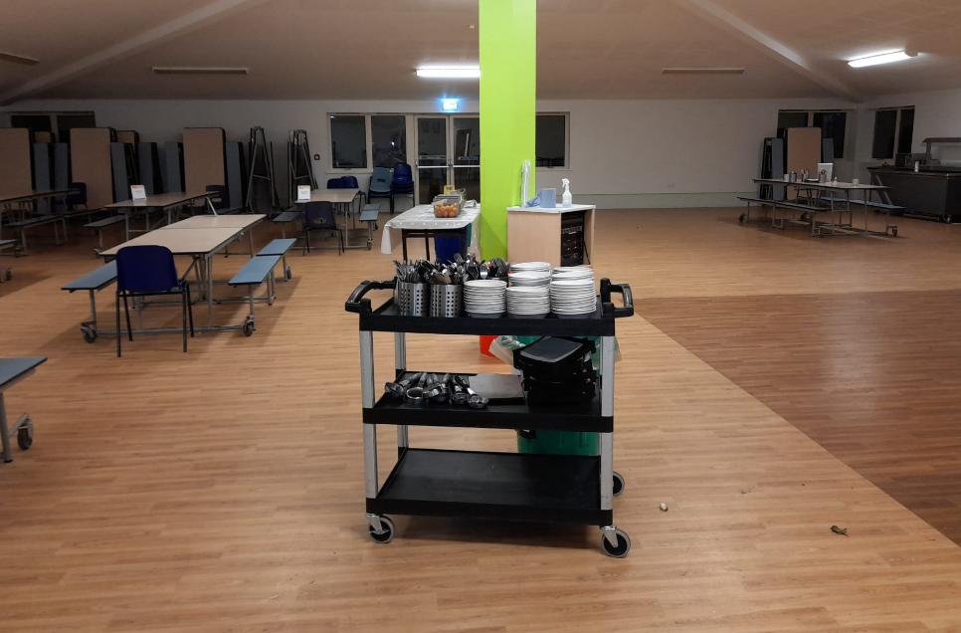
Food
All meals included from arrival day lunch to departure day lunch
All dietary needs catered for – this should be detailed on the consent form/medical summary
Mid-morning and mid-afternoon snacks, plenty of drinks and fruit
Always more than one option
THEY WILL NOT BE HUNGRY – PLEASE DON’T SEND SNACKS!!
Notes:
ZOE

Slide 10
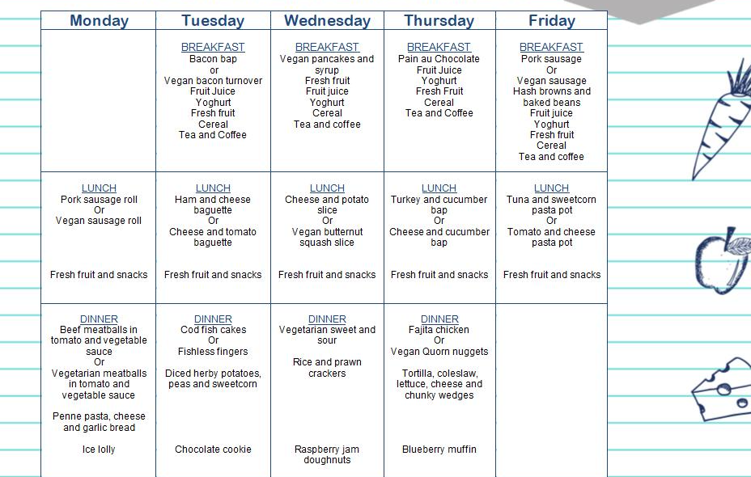
Sample Menu

Slide 11
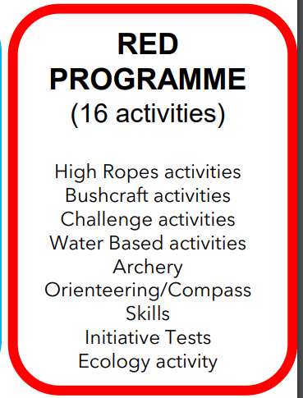
Activities and Groups
Children will be split into 4 groups with 11 or 12 in a group
Each group will include a qualified instructor and a member of school staff
Programme of morning, afternoon and evening activities
All specialist equipment included
Notes:
11
ZOE

Slide 12
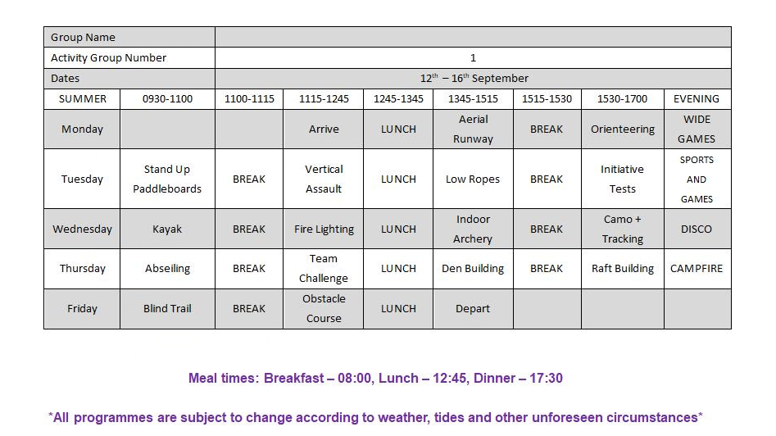
Notes:
ZOE

Slide 13
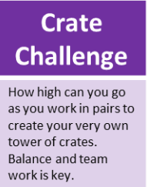
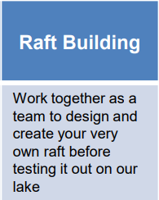
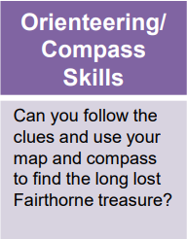
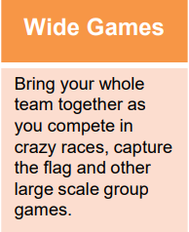
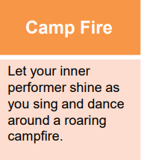
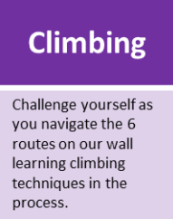
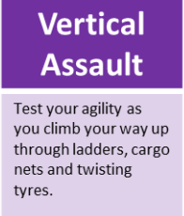
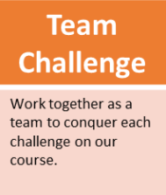
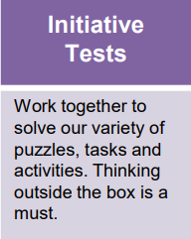
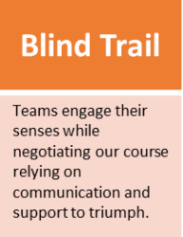
A range of challenges….
Games evening
Quiz Night
Epic Engineering
Film night
Notes:
ZOE These can be personalised for the group. If the programme is not written when you do the parents evening then use the sessions from last year and say that the group will be doing similar activities this year.
At this point talk through the general timings of the day and the structure of the sessions.
It is also useful to mention health and safety issues specific to the taught sessions e.g:
Trawling never takes place if it is too windy (it will be rescheduled or altered if this is not possible)
The driver of the trawler is also the driver of the lifeboat
All children wear full lifejackets

Slide 14
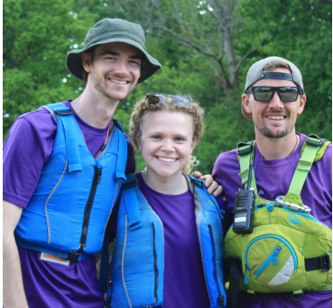
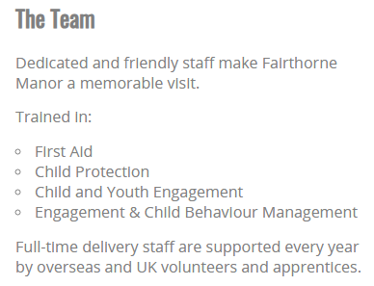
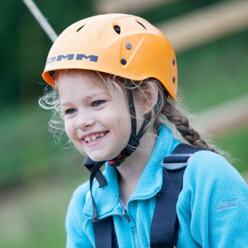
Staff and Safety
Instructors are fully trained and assessed in all the activities they deliver.
In house – highly qualified senior staff
Qualifications – National Governing Bodies
https://ymca-fg.org/residential-visits/
Notes:
14
CLARE Stress the clear handovers and direct supervision of all KS2 children at all times.
Mention that there is a duty manager on site throughout the night as well as a security guard. Rooms have locks on the doors that the children are told to use at night-time BUT the teachers have master keys that can override these and the locks open once the handle is turned on the inside.

Slide 15
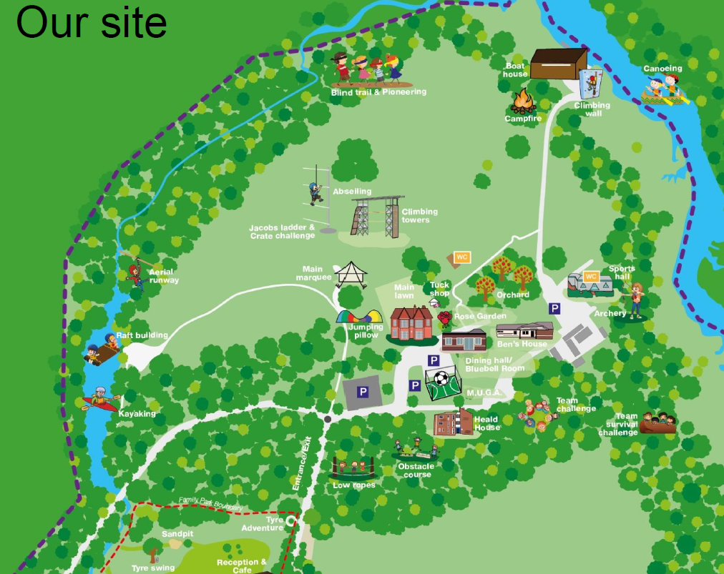

Slide 16
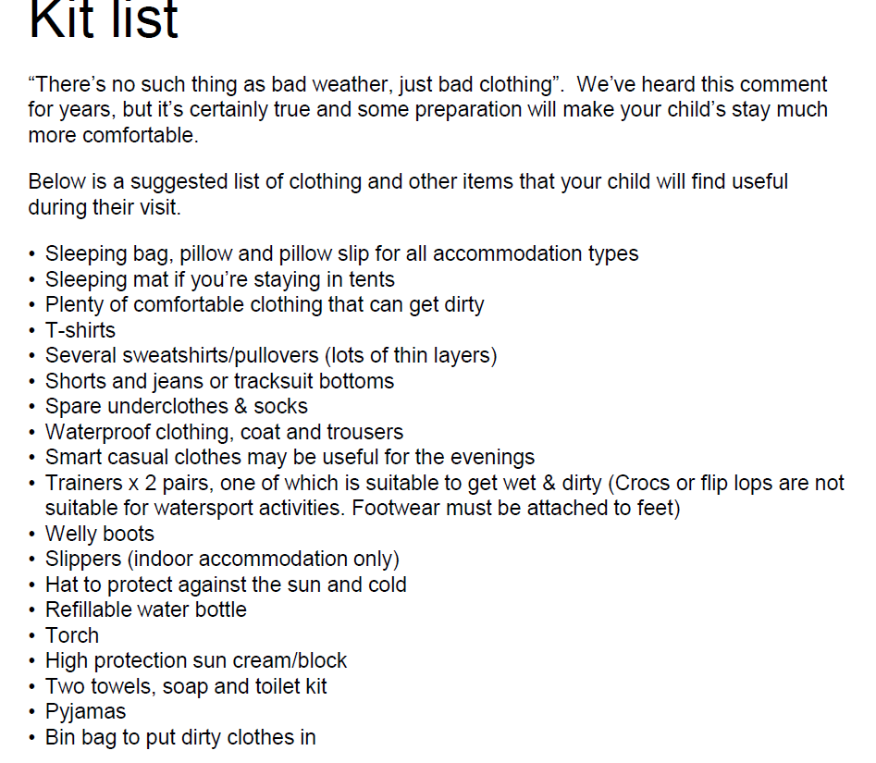
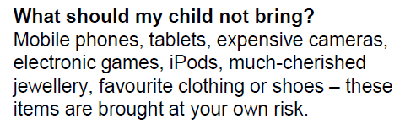
Waterproof trousers not essential – if you have spare trousers
Sleeping bags and pillows
2 trainers (one pair that can get wet or
wetsuit booties)
No money or mobile phones!
Notes:
ZOE Remind parents about this pack (they would receive it a term or so before the trip). Check whether the school has received them by looking on the T-cards in the main office. The schools with a blue dot have already been sent them. If they have not been sent then take the appropriate number with you and place a blue dot on the T-card.
Stress the importance of completing and returning the medical form as fully as possible and that the information is treated confidentially but is passed to the instructors who are teaching the group so they are aware.
Also encourage any dietary requirements to be stipulated on the form.
The centre MUST have this information an all children visiting.

Slide 17
Final Steps – Further Information
Medical information – form will be emailed out on the first day back in September and put on class web pages. Please completed and return by Friday 8th September. Details will be checked and all appropriate information shared with all staff or group leaders
Please continue to pay the full balance of £370 in instalments. The total is due by 31st March 2024.
Notes:
CLARE Remind parents about this pack (they would receive it a term or so before the trip). Check whether the school has received them by looking on the T-cards in the main office. The schools with a blue dot have already been sent them. If they have not been sent then take the appropriate number with you and place a blue dot on the T-card.
Stress the importance of completing and returning the medical form as fully as possible and that the information is treated confidentially but is passed to the instructors who are teaching the group so they are aware.
Also encourage any dietary requirements to be stipulated on the form.
The centre MUST have this information an all children visiting.

Slide 18
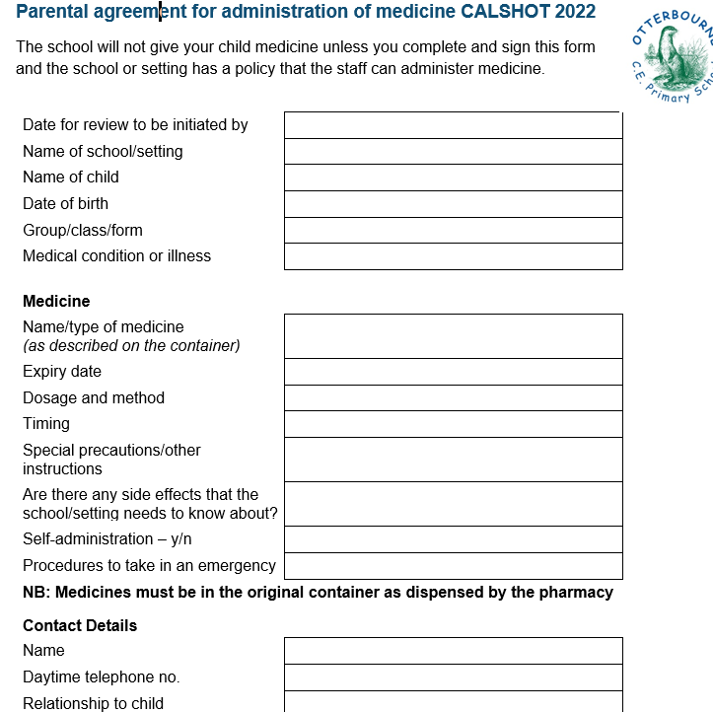
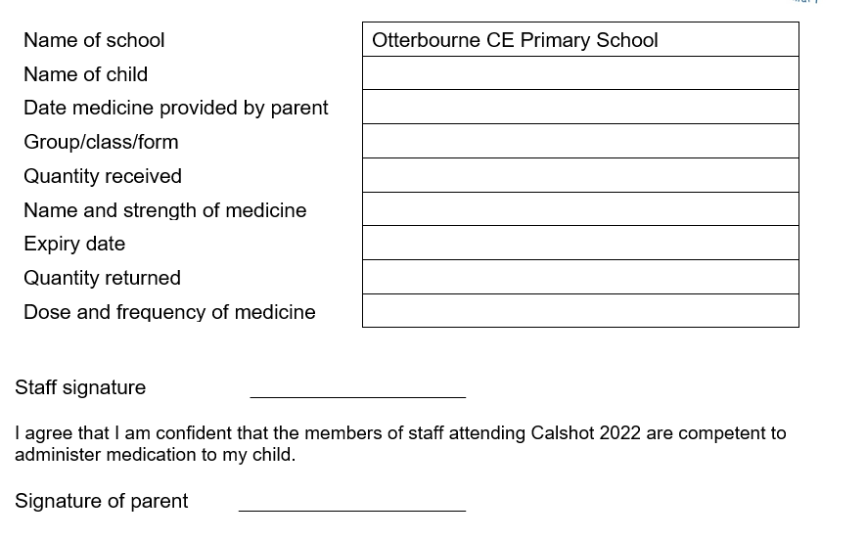
Final Steps – Further Information
Medical consent will need to be given, on the morning of the trip, as we receive the medicine
All of this one….
…the top section of this one
Notes:
CLARE Remind parents about this pack (they would receive it a term or so before the trip). Check whether the school has received them by looking on the T-cards in the main office. The schools with a blue dot have already been sent them. If they have not been sent then take the appropriate number with you and place a blue dot on the T-card.
Stress the importance of completing and returning the medical form as fully as possible and that the information is treated confidentially but is passed to the instructors who are teaching the group so they are aware.
Also encourage any dietary requirements to be stipulated on the form.
The centre MUST have this information an all children visiting.

Slide 19
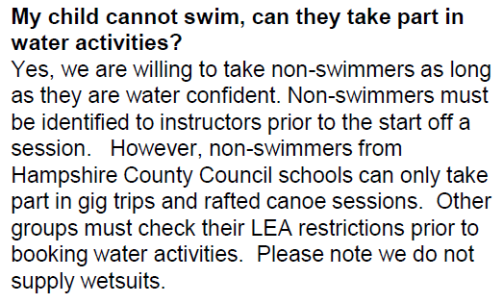
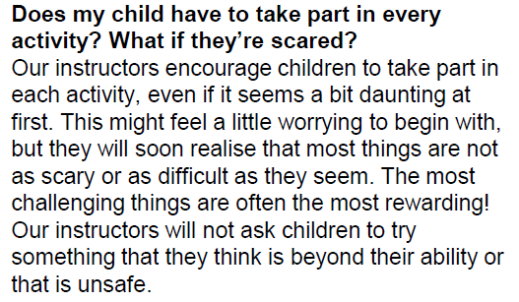
Final Steps – Further Information
Please keep payments going
Complete all forms, and return
Please email the office with any questions you might have…they will forward them on to me
Notes:
CLARE Remind parents about this pack (they would receive it a term or so before the trip). Check whether the school has received them by looking on the T-cards in the main office. The schools with a blue dot have already been sent them. If they have not been sent then take the appropriate number with you and place a blue dot on the T-card.
Stress the importance of completing and returning the medical form as fully as possible and that the information is treated confidentially but is passed to the instructors who are teaching the group so they are aware.
Also encourage any dietary requirements to be stipulated on the form.
The centre MUST have this information an all children visiting.

Slide 20
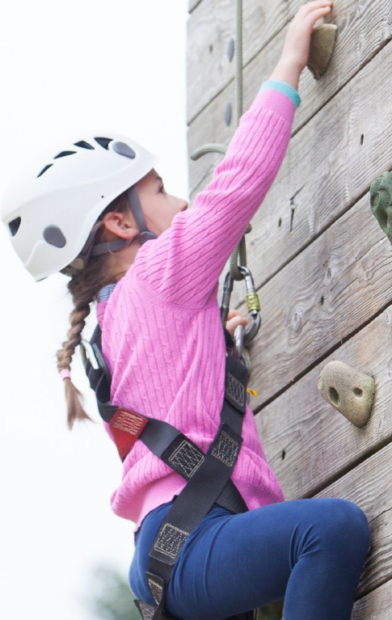
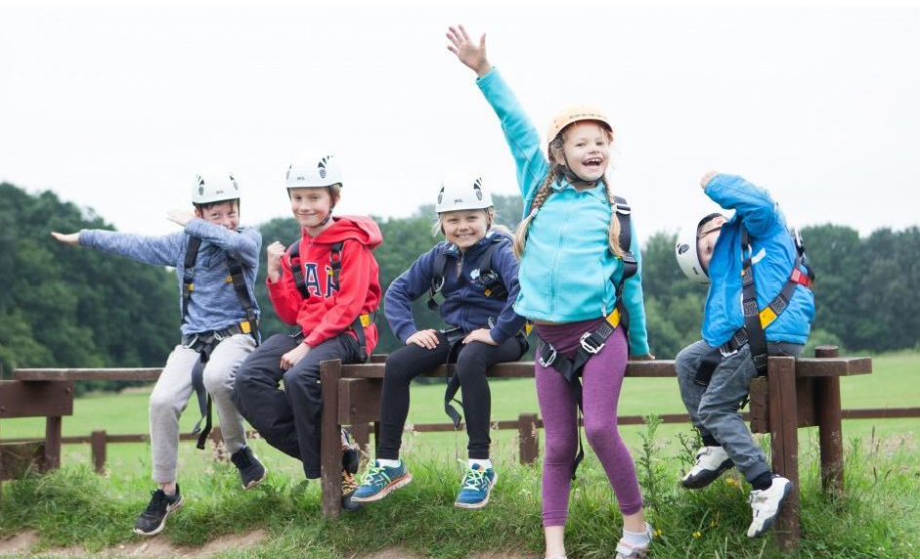
Any Questions?
Notes:
CLARE

