Slide 1

Year Two
Early Reading (and spelling and phonics!)

Slide 2
Reading is fundamental to education. Proficiency in reading, writing and spoken language is vital for pupils’ success. Through these, they develop communication skills for education and for working with others: in school, in training and at work.
DfE Reading Framework 2023

Slide 3
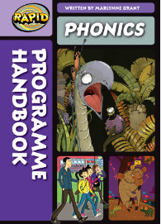

At Otterbourne, our SSP (systematic, synthetic phonics) programme is Bug Club by Pearson.
We also use Rapid Phonics which is by Pearson for children in Year 2 and onwards as a catch up programme for reading and spelling.

Slide 4
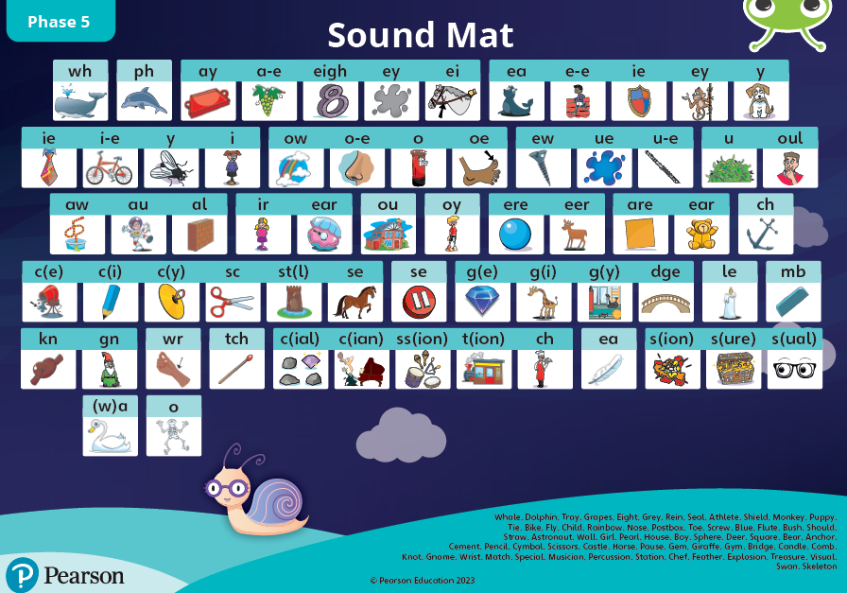
Year One – Phase 5 – alternative graphemes

Slide 5
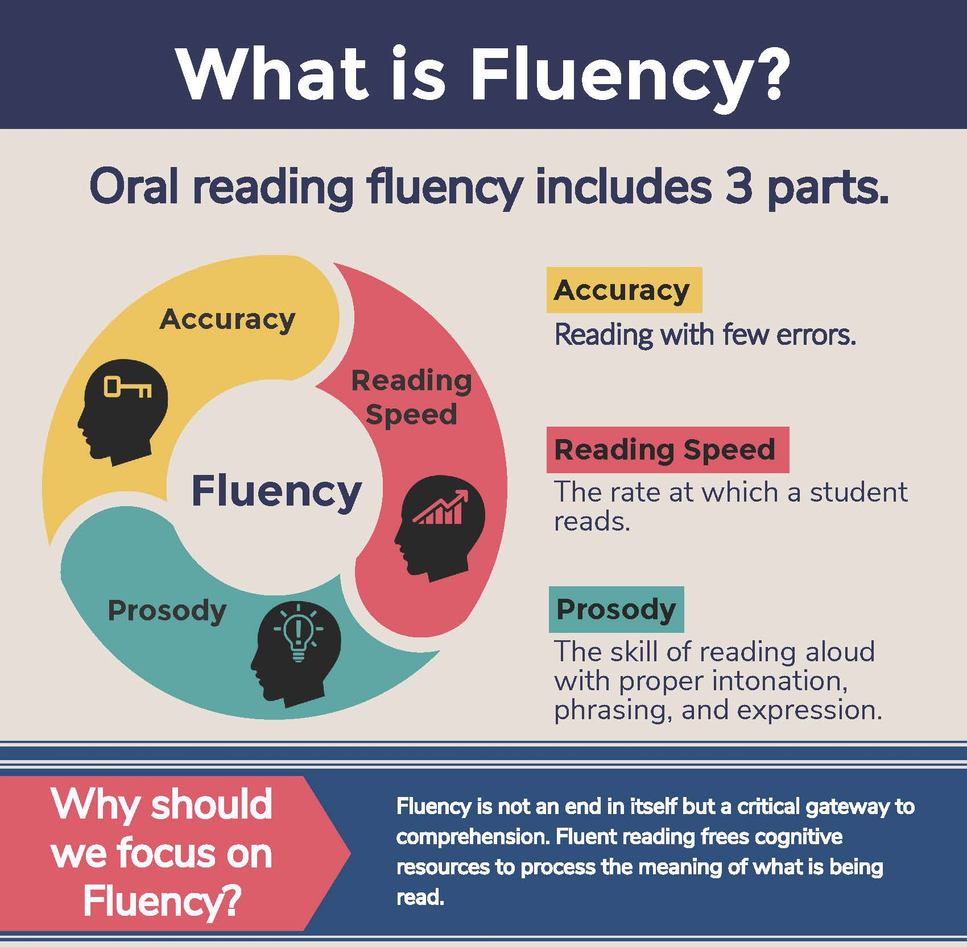
Bug Club Books - phonics
Following the Hampshire Reading approach, some of the children will come home with a Bug Club book each week. This book will focus on a sound that has already been covered in Year One phonics but needs consolidating.
The goal is to build fluency in the children’s reading.
We are following the 3 read approach throughout the week so your child will have read part of their book 3 times before it goes home.

Slide 6
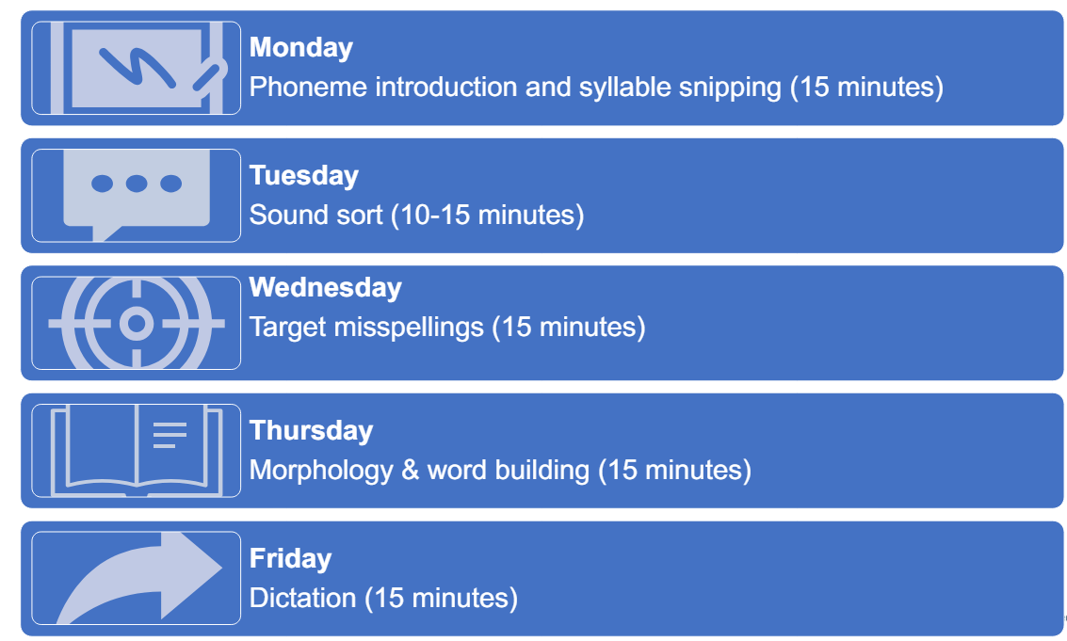
Spellings
In Year 2, children take part in spelling lessons. These lessons focus on the sounds the children have learnt in their phonics lessons in Year R and Year One.

Slide 7
Coloured Book Bands
Your child may be on a coloured book band. They will come home with some of these books every week. They change them on a Wednesday.
Platinum
Free Reader

Slide 8
Three ways you can help build fluency at home…
Read and follow – the adult reads the text and the child follows along with their finger. This helps the child with word recognition and models to them how they should read with fluency.
My turn, your turn – take turns reading a page or a paragraph. Here you are modelling how to read with fluency, flow and expression.
Echo Reading – as you read, the child copies. It is important here to pace yourself and read at a rate that your child can keep up with.

Slide 9
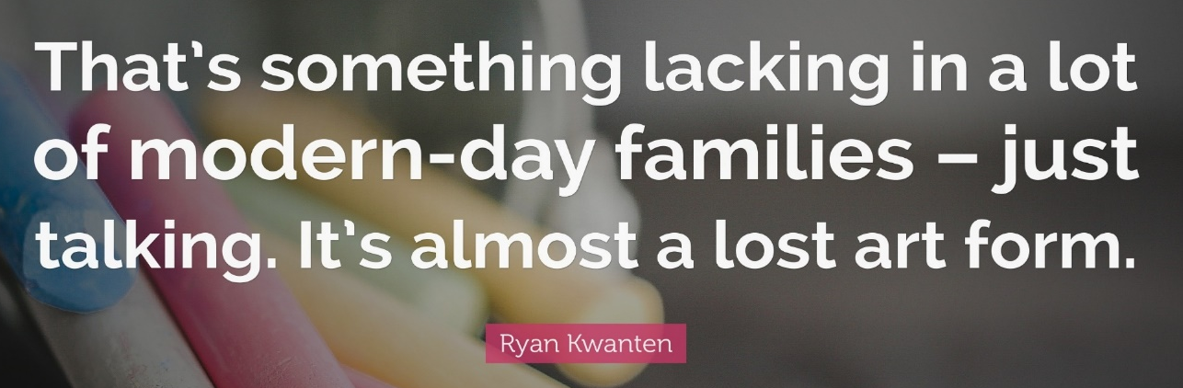
What you can do to help develop comprehension…
Comprehension of the world will develop comprehension in reading…
Ways you can develop comprehension –
  Talking a lot at home… about everything
  Develop cultural capital by going out (this does not have to cost money)
  Reading together and discussing books together
    Why do you like this book?
    What do you think will happen next?
    What do you think about this character?

Slide 10
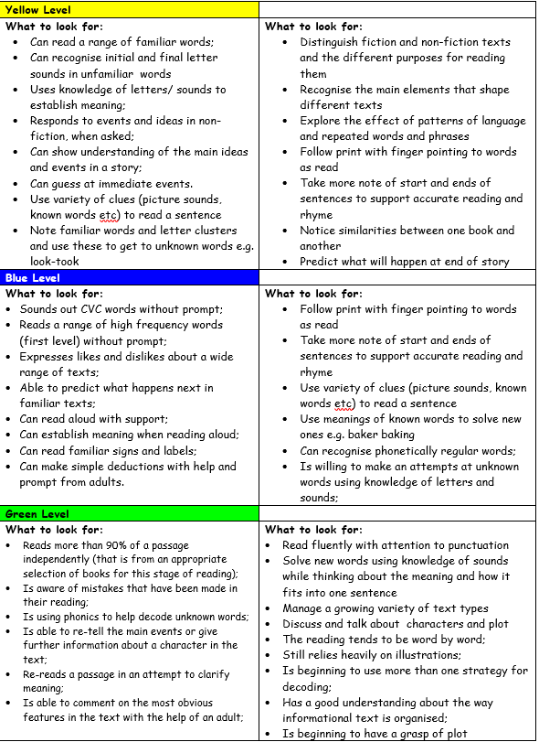

Slide 11
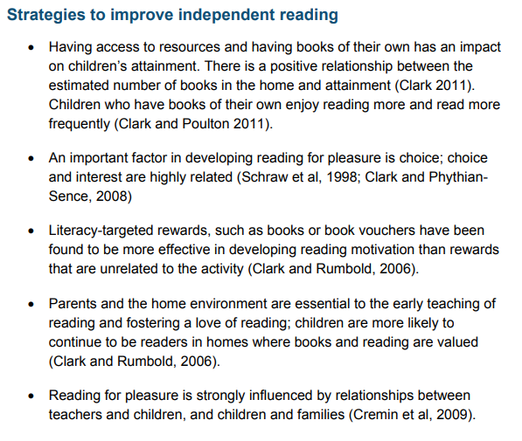
How to encourage independent reading at home
Having books that the child owns
Using the library to help build variety
Exposing children to texts beyond novel. E.g. comics, magazines, non-fiction books
Taking control of screens – reading first and then screentime
Show that you love reading… even if you have to fake it
Give children books that matter to them
Reward reading through extrinsic and intrinsic motivators

Slide 12







A bedtime story
A bedtime story doesn’t require children to focus on the mechanics of learning to read, but on the enjoyment of the story and the idea of being transported to other worlds before drifting into dreams about them.’

Slide 13
Library Books
Every Wednesday, your child will go to the school library and be able to swap their library books.
Please support your child in remembering to put their library books in their book bag on a Wednesday.

Slide 14
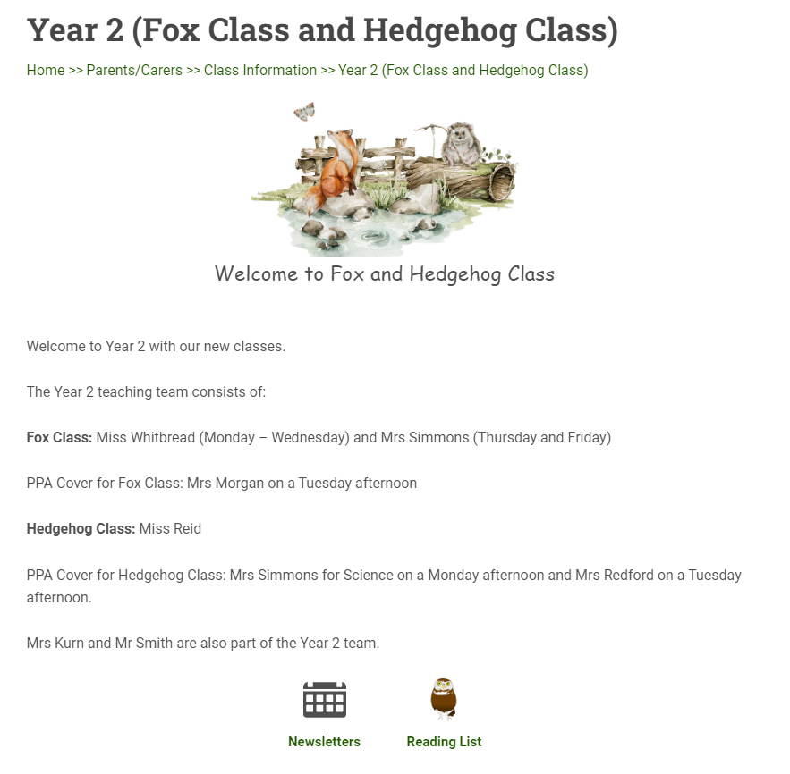

Slide 15
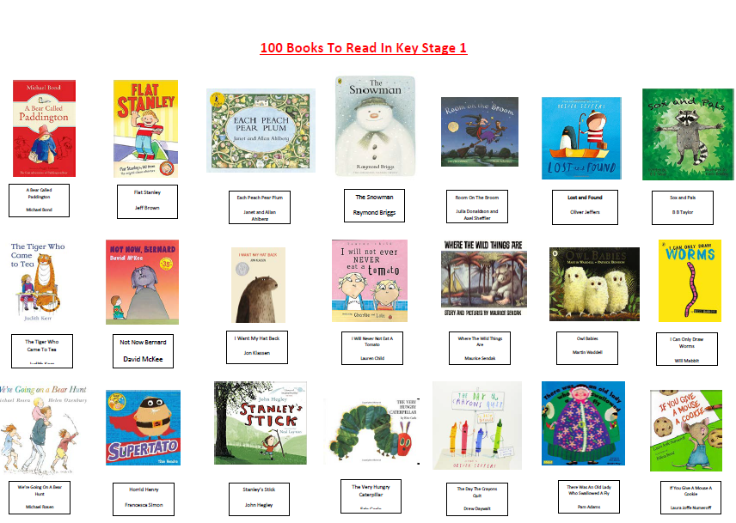

Slide 16
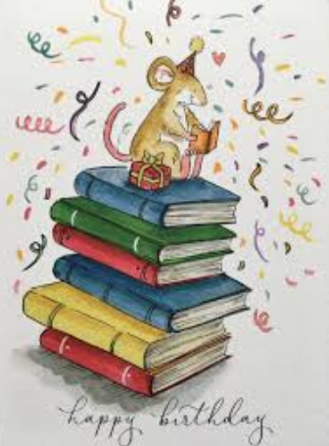

Birthday Books
In order to develop reading culture within the school, we are bringing back birthday books.
The School Library Service (SLS) have created a list of new books that will enhance our library. These books have been added to a Wish List with LoveReading4Kids.
When it is your child’s birthday, they can purchase one of the books from the list and bring it to the office. A special birthday slip will then be stuck in the front so that it can be presented to the school in celebration assembly and spread excitement about new books and authors.
The school can earn money on all purchases made in order to buy further new books.
https://www.lovereading4kids.co.uk/wishlists/71ea18c474d87aa37cc5e222c83287ca

