Slide 1

Year One
Phonics and Early Reading

Slide 2
Reading is fundamental to education. Proficiency in reading, writing and spoken language is vital for pupils’ success. Through these, they develop communication skills for education and for working with others: in school, in training and at work.
DfE Reading Framework 2023

Slide 3
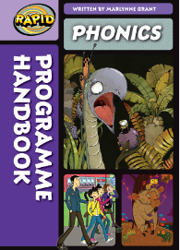

At Otterbourne, our SSP (systematic, synthetic phonics) programme is Bug Club by Pearson.
We also use Rapid Phonics which is by Pearson for children in Year 2 and onwards as a catch up programme for reading and spelling.

Slide 4
Phonics through the year groups
Year R – Phase 1 – listening and attention
Sound walks
Rhyming
Syllables
Songs / rhythm
Sharing books
Games e.g. Silly Soup for alliteration, What’s in the box? – animal noises

Slide 5
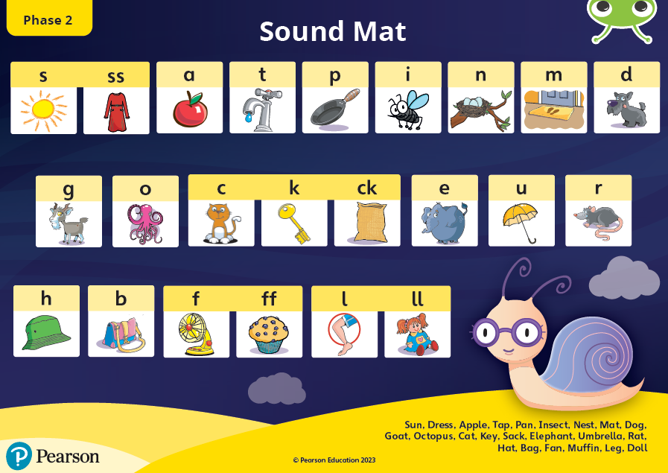
Year R Starting Point – Phase 2

Slide 6
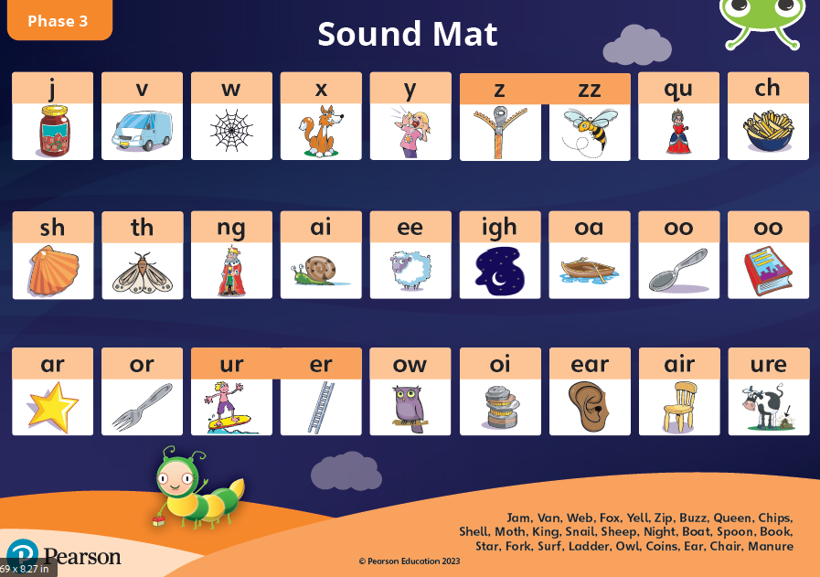
Year R – Phase 3 – digraphs and trigraphs

Slide 7
Year R – Phase 4
Adjacent consonants / consonant clusters
CVCC – e.g. list
CCVC – e.g. frog
CCVCC - e.g. stamp
CCCVC - e.g. scrub
CCCVCC - e.g. shrink

Slide 8
Year R – ‘tricky words’ / irregular words
Throughout Phases 2, 3 and 4, the children are also taught ‘tricky words’ e.g. I, go, no, she – these are taught through Language Lessons.
Focus on identifying which part of the word is ‘tricky’.

Slide 9
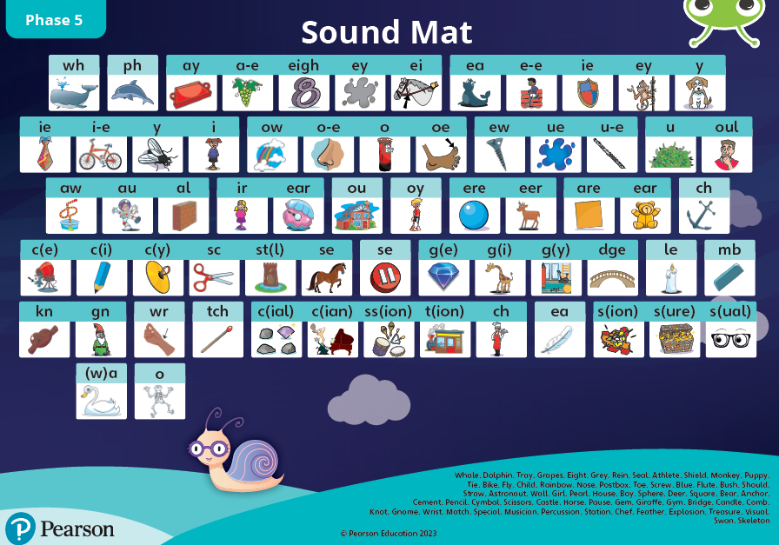
Year One – Phase 5 – alternative graphemes

Slide 10
Year One – ‘tricky words’ / irregular words and High Frequency Words
‘Tricky words’ e.g. who, again
High Frequency words e.g. Thursday, thirty
These are taught through Language Lessons.
Language Lessons in Year One also cover aspects such as apostrophes for contractions e.g. don’t and prefixes and suffixes.

Slide 11
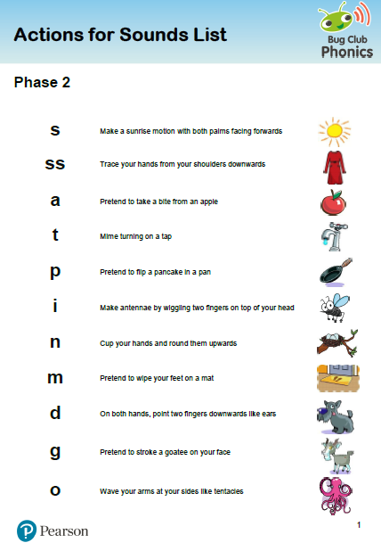
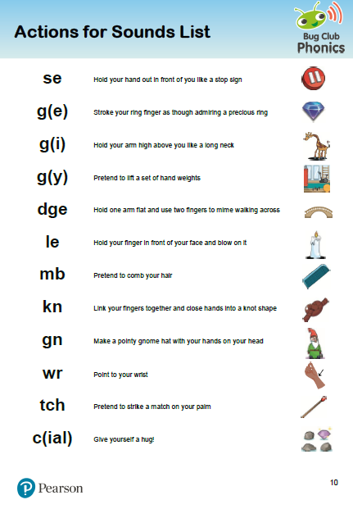
Actions and pictures

Slide 12





3

Slide 13
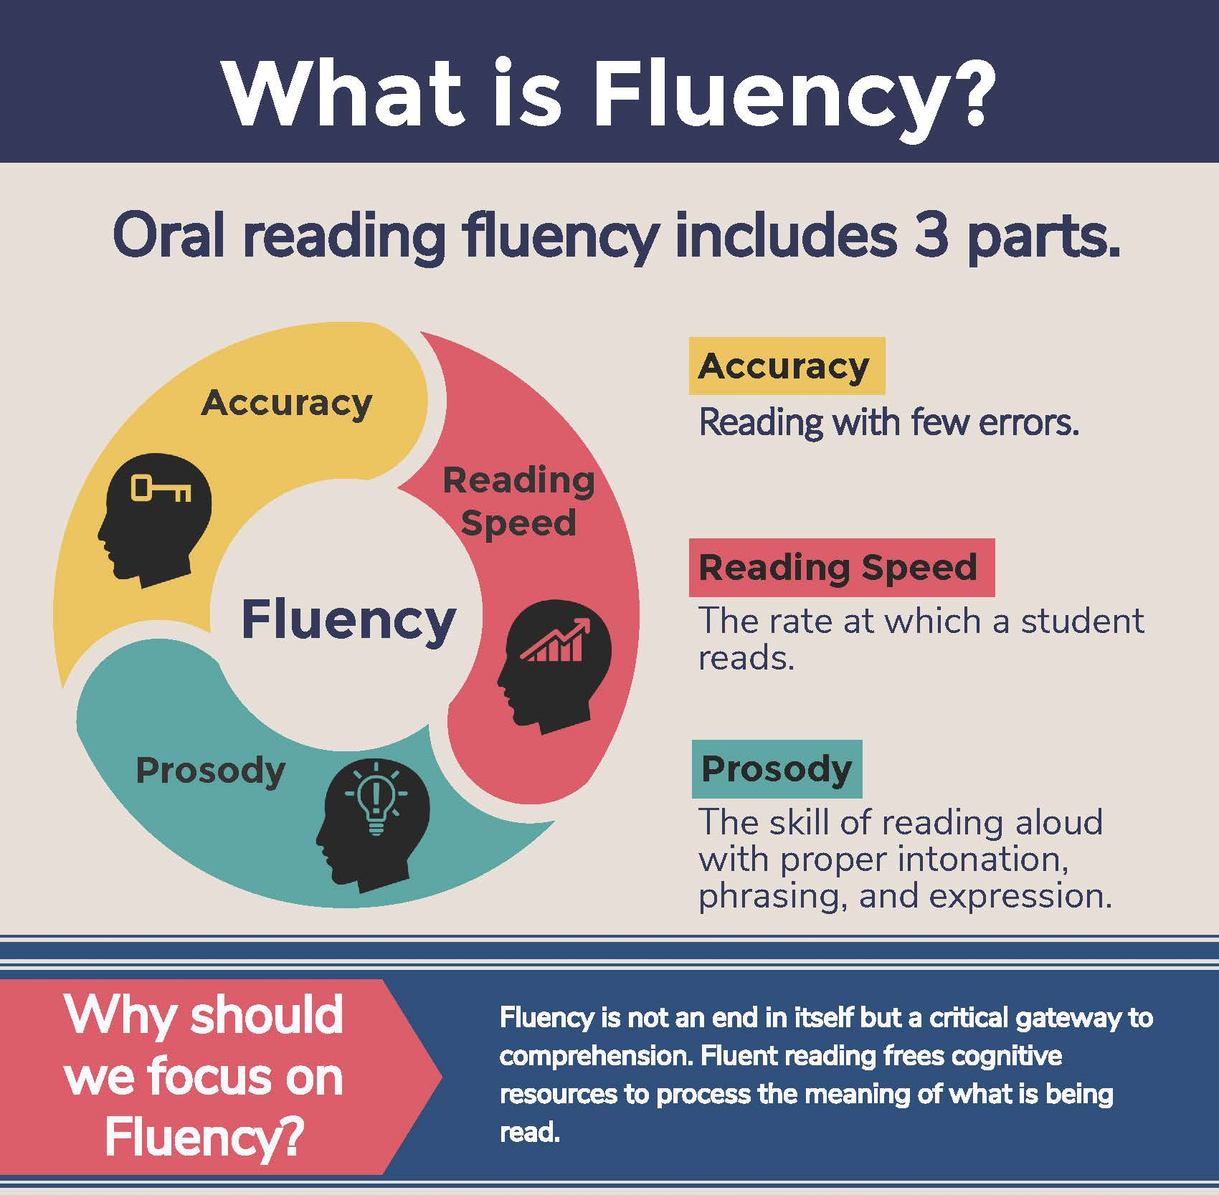
Bug Club Books - phonics
Following the Hampshire Reading approach, your child will come home with a Bug Club book each week. This book will focus on a sound that the class has already covered in phonics. I will write in their diary when I have read with your child and ask you to support them in any sounds or words they found a struggle. Please write in how often they read, they get house points!
The goal is to build fluency in the children’s reading.
We are following the 3 read approach throughout the week so your child will have read part of their book 3 times before it goes home.

Slide 14
Three ways you can help build fluency at home…
Read and follow – the adult reads the text and the child follows along with their finger. This helps the child with word recognition and models to them how they should read with fluency.
My turn, your turn – take turns reading a page or a paragraph. Here you are modelling how to read with fluency, flow and expression.
Echo Reading – as you read, the child copies. It is important here to pace yourself and read at a rate that your child can keep up with.

Slide 15
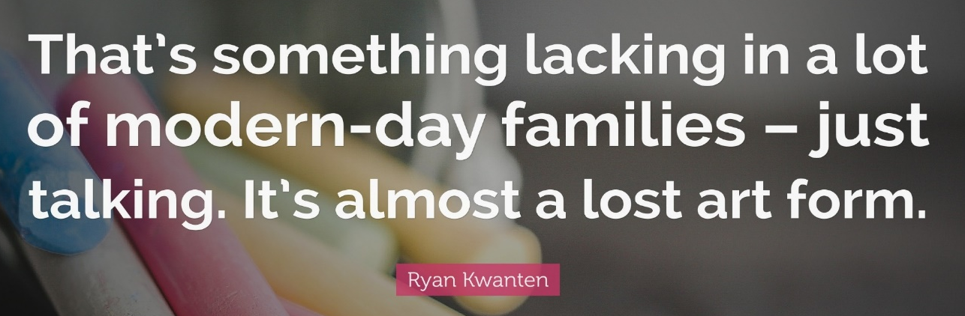
What you can do to help develop comprehension…
Comprehension of the world will develop comprehension in reading…
Ways you can develop comprehension –
  Talking a lot at home… about everything
  Develop cultural capital by going out (this does not have to cost money)
  Reading together and discussing books together
    Why do you like this book?
    What do you think will happen next?
    What do you think about this character?

Slide 16
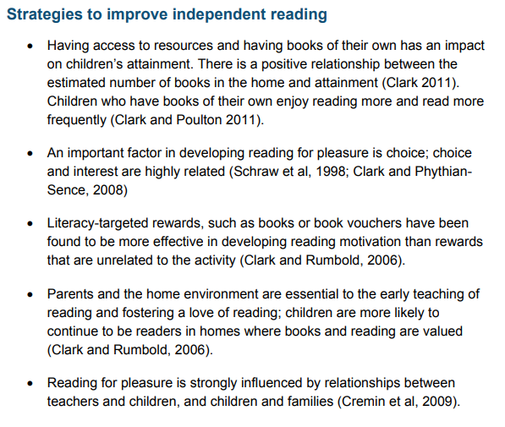
How to encourage independent reading at home
Having books that the child owns
Using the library to help build variety
Exposing children to texts beyond novel. E.g. comics, magazines, non-fiction books
Taking control of screens – reading first and then screentime
Show that you love reading… even if you have to fake it
Give children books that matter to them
Reward reading through extrinsic and intrinsic motivators

Slide 17







A bedtime story
A bedtime story doesn’t require children to focus on the mechanics of learning to read, but on the enjoyment of the story and the idea of being transported to other worlds before drifting into dreams about them.’

Slide 18
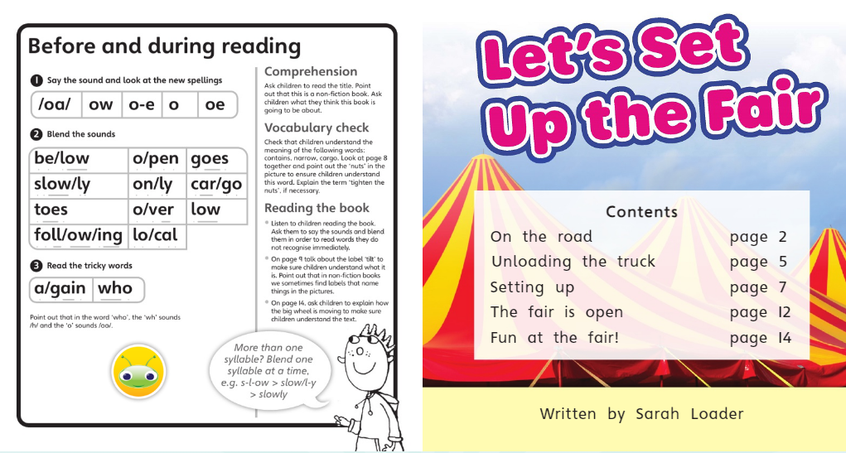

Slide 19
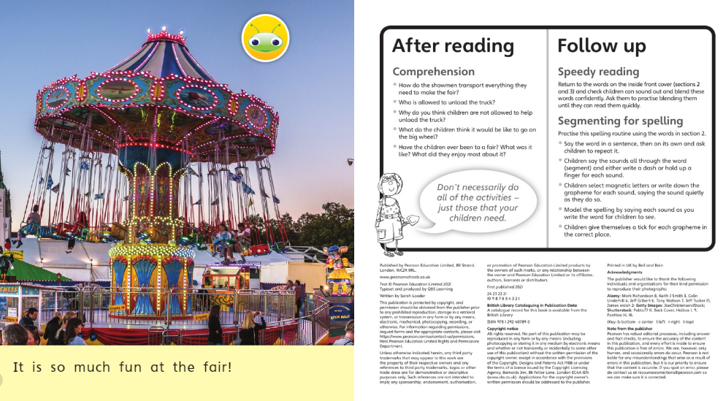

Slide 20
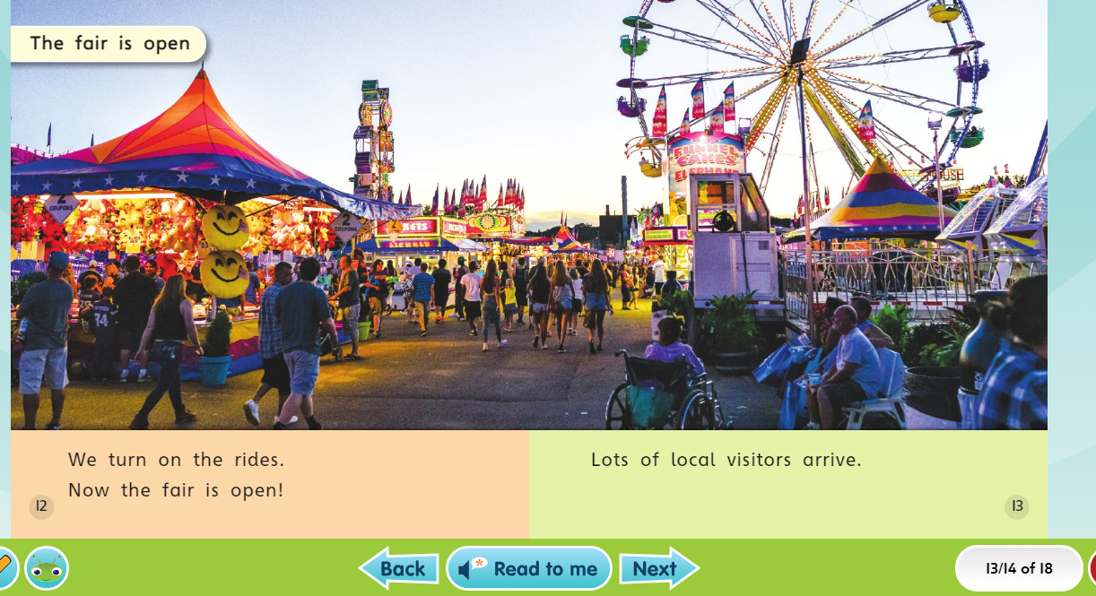
Bug Club Online – lots of books available

Slide 21
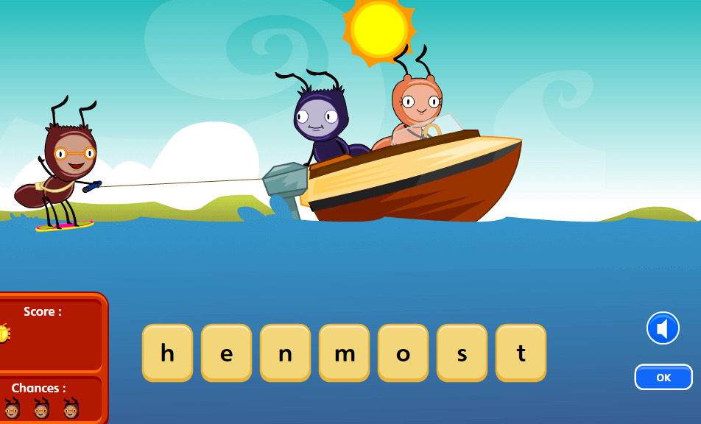
Bug Club Online – lots of games to support the focus sounds

Slide 22
Library Books
Every Friday, your child will go to the school library and be able to swap their library books.
Please support your child in remembering to put their library books in their book bag on a Friday.

Slide 23
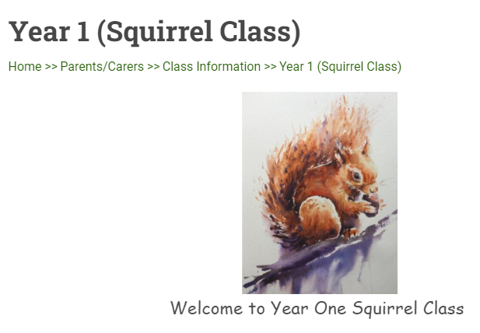


Slide 24
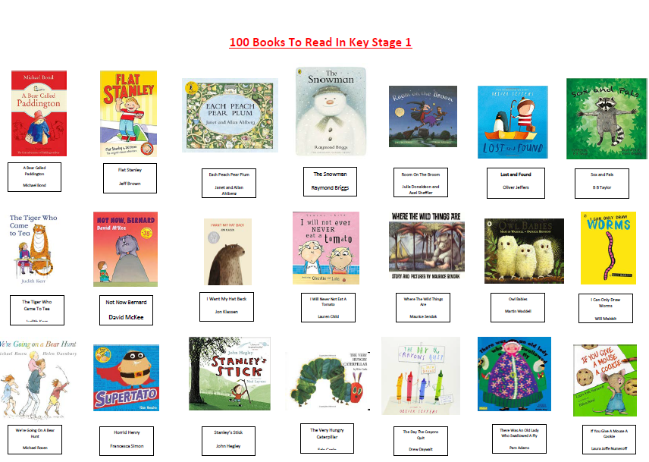

Slide 25
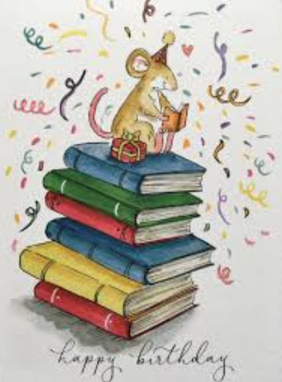

Birthday Books
In order to develop reading culture within the school, we are bringing back birthday books.
The School Library Service (SLS) have created a list of new books that will enhance our library. These books have been added to a Wish List with LoveReading4Kids.
When it is your child’s birthday, they can purchase one of the books from the list and bring it to the office. A special birthday slip will then be stuck in the front so that it can be presented to the school in celebration assembly and spread excitement about new books and authors.
The school can earn money on all purchases made in order to buy further new books.
https://www.lovereading4kids.co.uk/wishlists/71ea18c474d87aa37cc5e222c83287ca

Slide 26
Birthday Books
In order to develop reading culture within the school, we are bringing back birthday books.
The School Library Service (SLS) have created a list of new books that will enhance our library. These books have been added to a Wish List with LoveReading4Kids.
When it is your child’s birthday, they can purchase one of the books from the list and bring it to the office. A special birthday slip will then be stuck in the front so that it can be presented to the school in celebration assembly and spread excitement about new books and authors.
The school can earn money on all purchases made in order to buy further new books.
https://www.lovereading4kids.co.uk/wishlists/71ea18c474d87aa37cc5e222c83287ca

